Slide 1
HEART DISEASE PREDICTION USING KNN
M.DHARANI
19RH1A05E0

Slide 2
Heart disease prediction using KNN
Introduction
Flow chart
Code layout
Visualization of code
Advantages
Disadvantages
Application
Future development

Slide 3
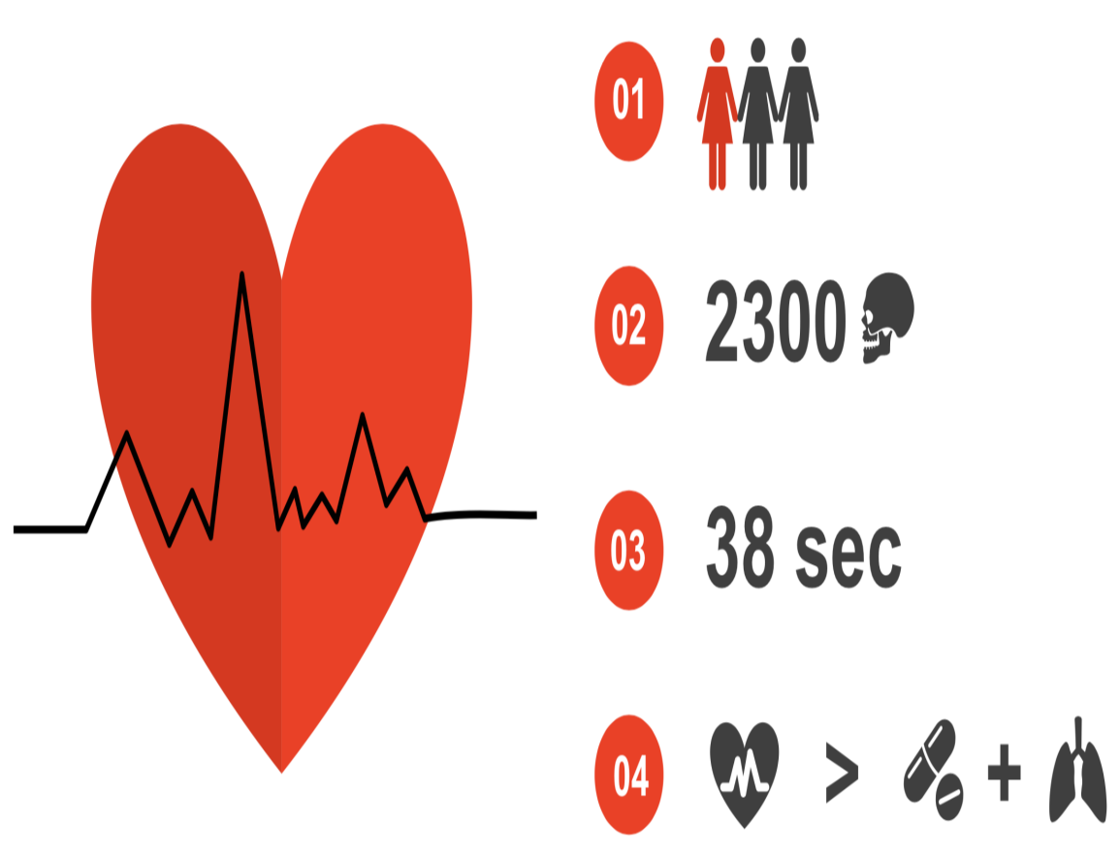
Introduction
It is easy to predict heart diseases now a days using ML
80% of heart disease prediction is done accurately
It needs just 10 mins to check your health
Just fill your symptoms and check it out

Slide 4
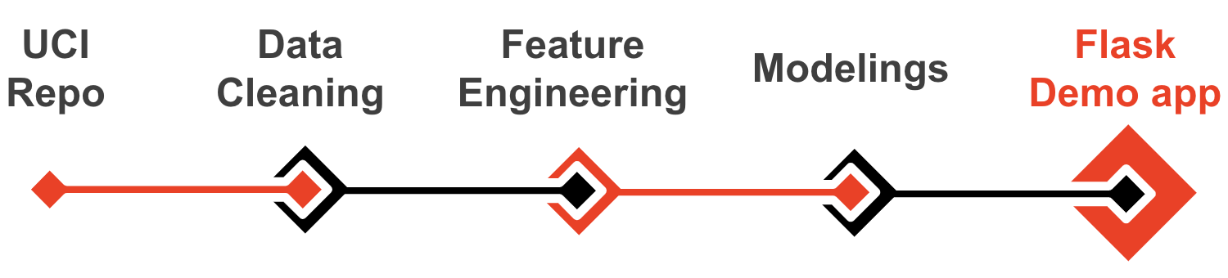
Flow chart

Slide 5
Code layout
Collection of data
Cleaning and EDA
Modelling and feature engineering
Data visualization
Confusion matrix
Accuracy

Slide 6
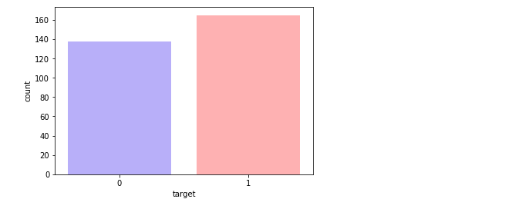
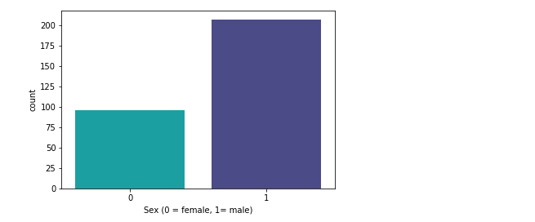
Visualization of code

Slide 7
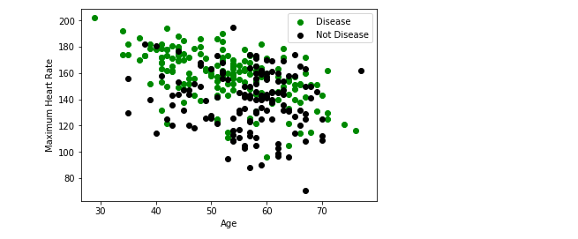
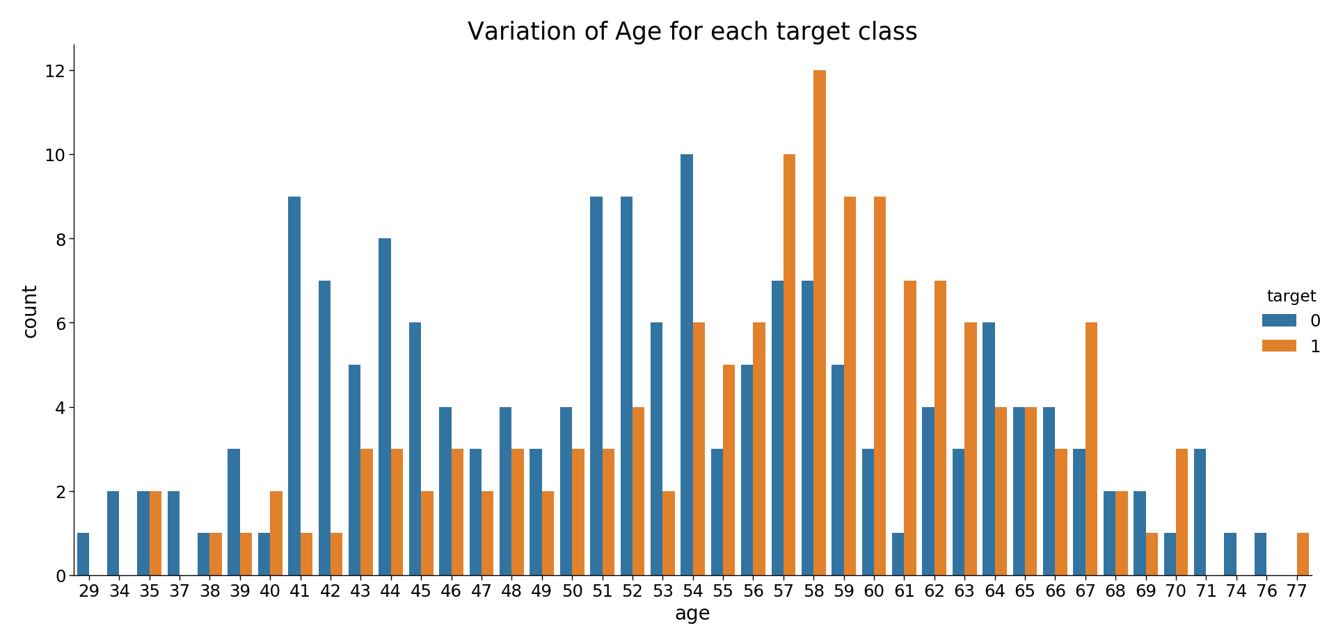
Visualization

Slide 8
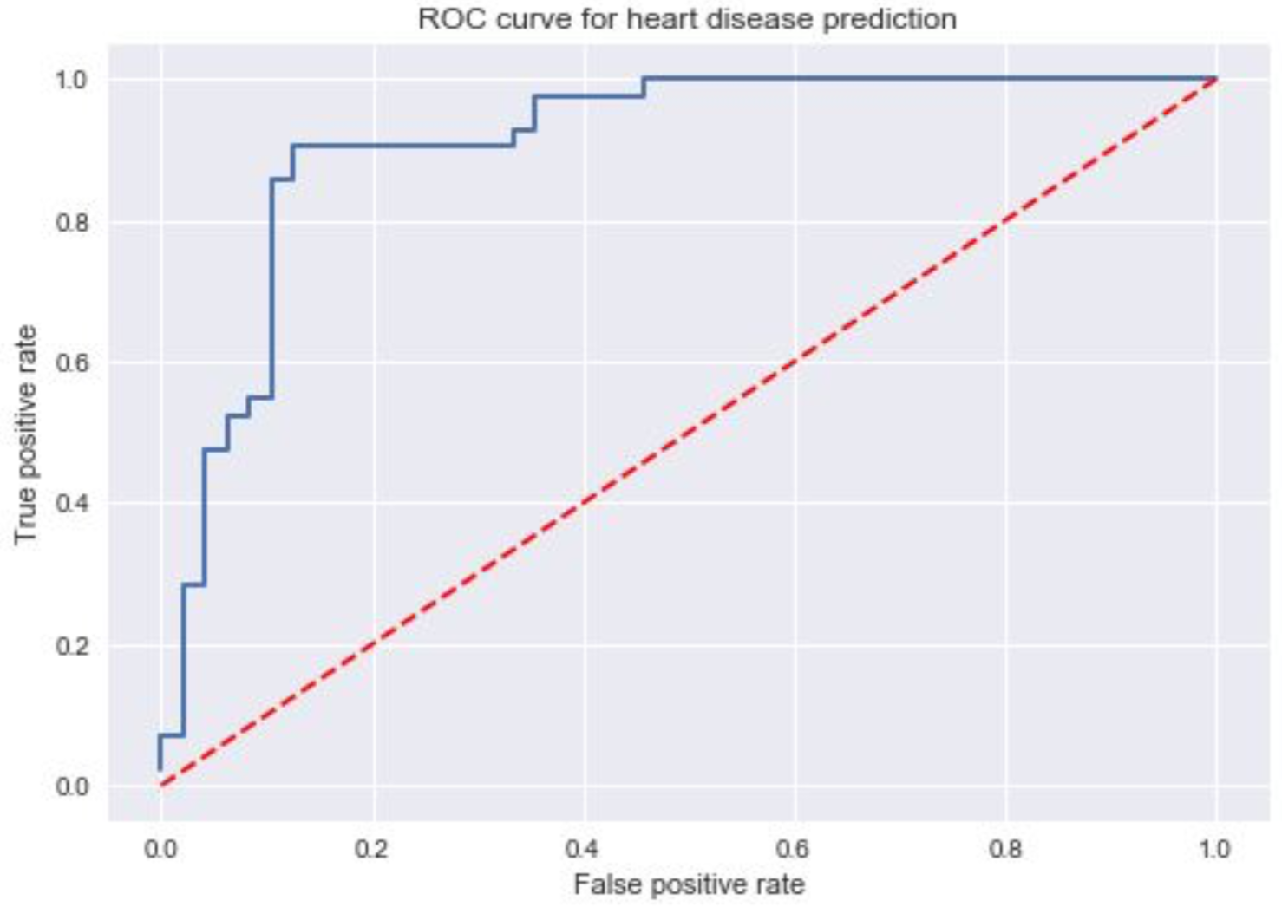
Visualization

Slide 9
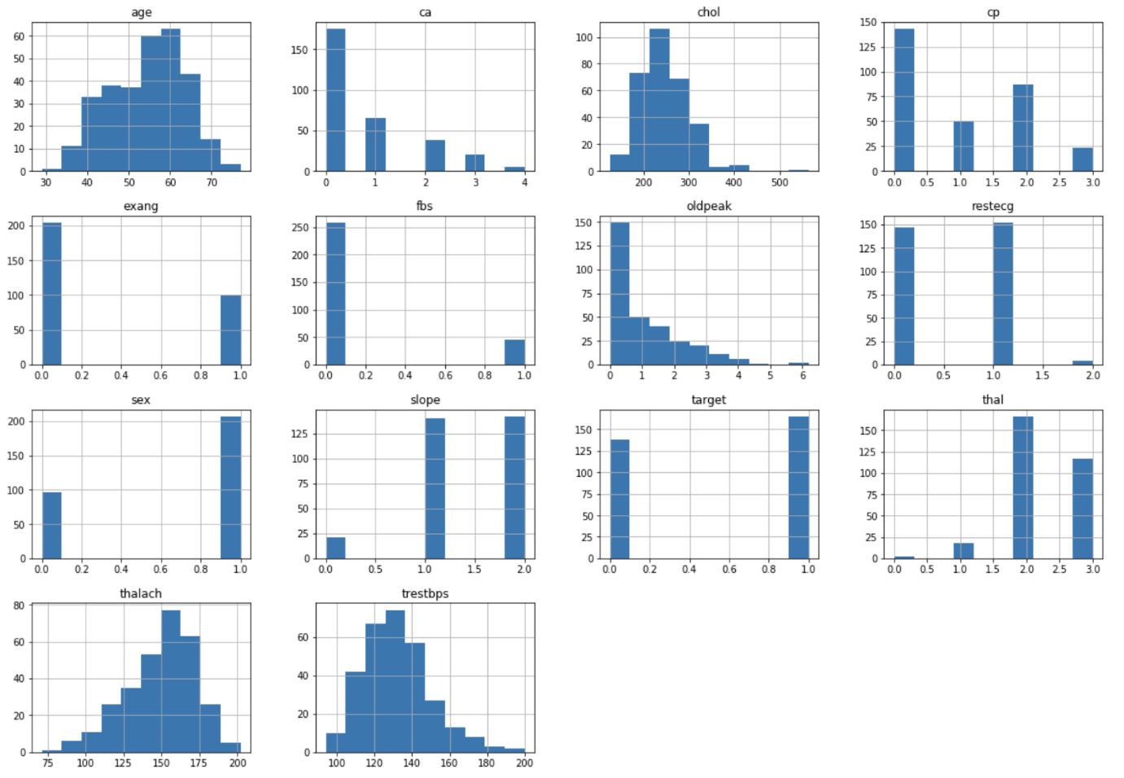
Visualization

Slide 10
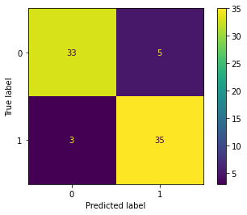
Confusion Matrix

Slide 11

Advantages
Accurate Prediction
Time saving
User friendly
Access from home
Suggestions
First aid

Slide 12

Disadvantages
Privacy and Security
New challenges every day
Massive Data Sets
Efficient Algorithm
Different body types
Financial Problems

Slide 13

Applications
Machine learning algorithms
Predictions are easy!!
Diagnosis
Preliminary heart diseases prediction

Slide 14

Future Development
Many other diseases can be predicted
Software Development
Hardware Development
Rapid Diagnosis treatment

Slide 15


